Slide 1
ORCID Value Stories

Slide 2
Why Value Stories?

Slide 3
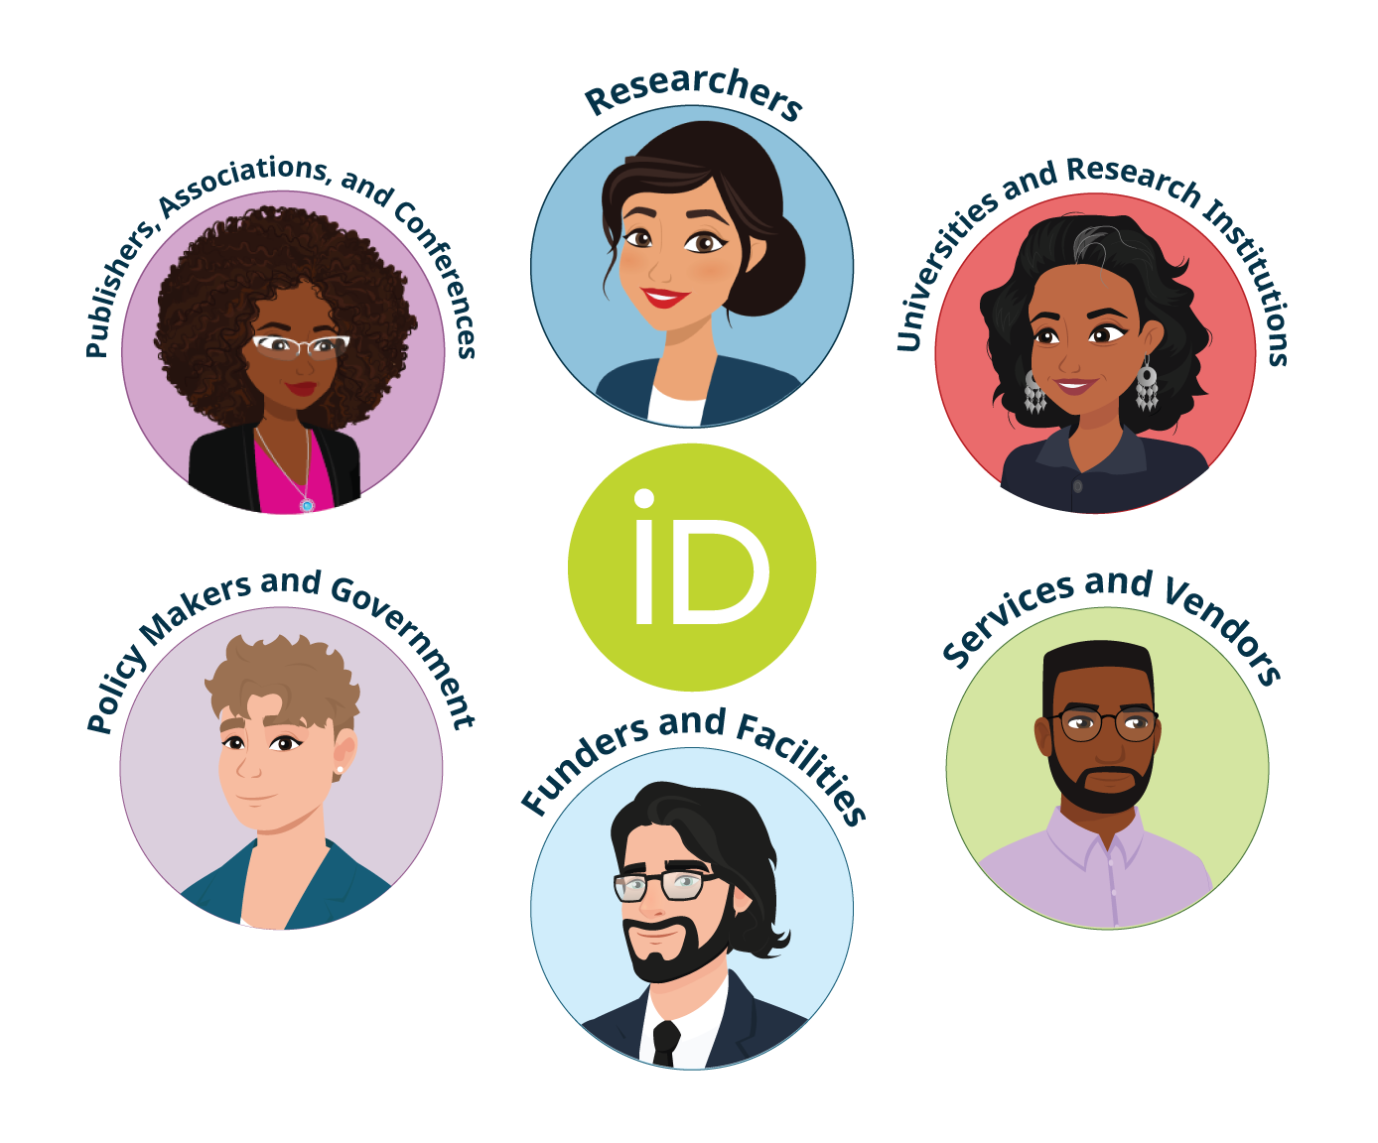
ORCID’s value stories are both value propositions and benefit statements
ORCID has multiple stakeholders
Complex product and service offerings
Notes:
Powerful value stories help our stakeholders truly understand the value of ORCID’s products and services. We hear about “value proposition” a lot, is that different from a value story? In short - yes. It’s a mix of both value propositions and benefits statements - it’s more helpful to the ORCID community because we have multiple stakeholder groups, and we offer complex products and services. A simple value proposition won’t really work for us.

Slide 4
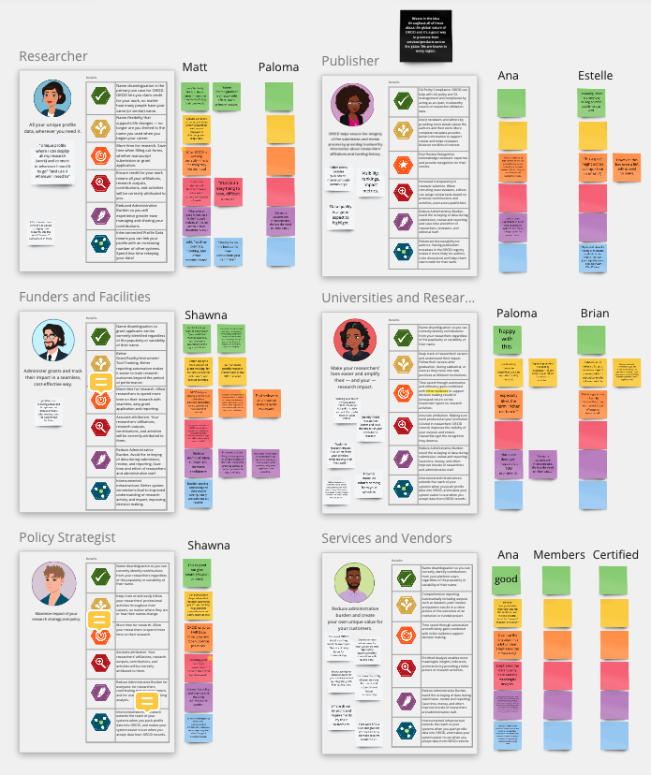
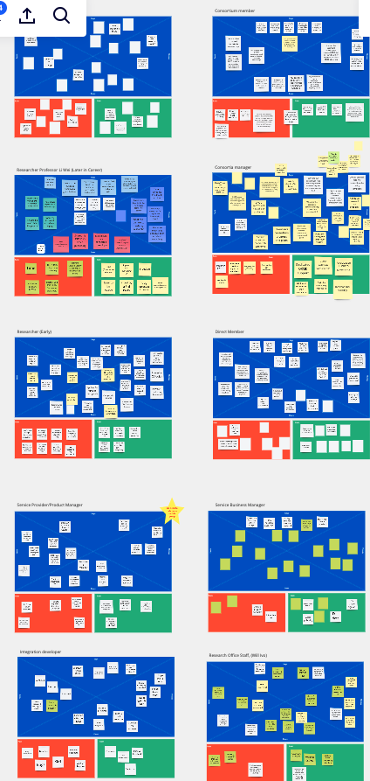
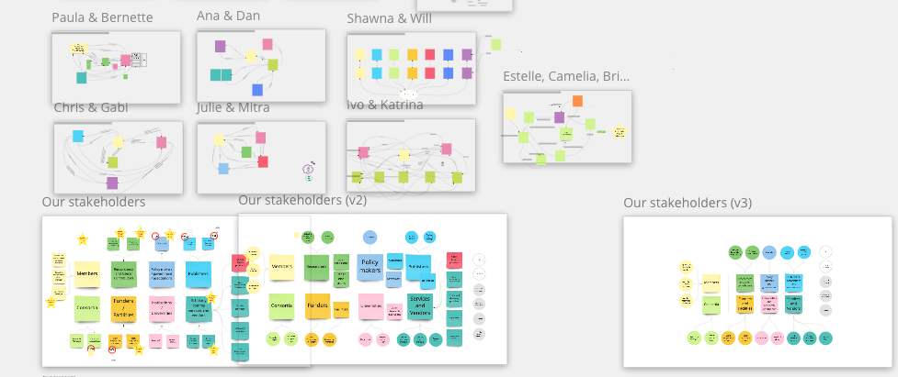
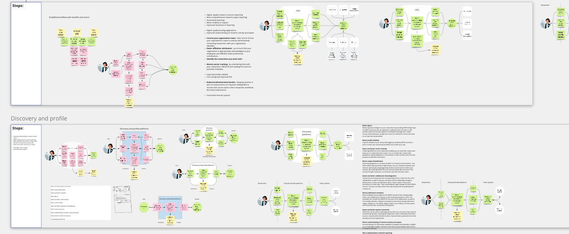
A lot of input fed into the development of our value stories
Member/User Value Research
Stakeholder mapping
  Stakeholder descriptions
  Persona descriptions
Stakeholder benefits workshops
Empathy mapping
  What our stakeholders feel, say, think, do
  What are their pains, what do they hope to gain
Personae development
Internal/external message review and refinement
ORCID Board review
Final staff refinement
Notes:
ORCID’s Value Stories are the culmination of a lot work conducted across all ORCID teams, starting with the in-depth member and user value research projects, stakeholder mapping workshops where we categorized and described our stakeholder groups, as well as developed empathy mapping to articulate what our users feel, say, think and do, and what they hoped to gain. We’ve tested them in various external environments to get feedback and spent a good deal of time carefully refining each message with internal subject matter experts. In late 2021, we worked with our Board to gain their insight and feedback, which was really helpful since we were able to bring external subject matter expertise from across ORCID’s community to all of our stakeholder value messaging.

Slide 5
How to use Value Stories

Slide 6
Please feel free to use these wherever you need to communicate ORCID’s value to your researchers or colleagues
ORCID’s Value Stories can be used any place you need to help your researchers, partners, or colleagues understand the value ORCID can bring. Simply use the messages for the audience you intend to communicate with. They can be woven throughout your website, used in your own outreach resources, blog posts, social media, engagement materials, presentation templates, emails, documentation, support communication, or internal communications.
To use, go to File > Make a copy > Entire presentation and browse to your own Google workspace, and Save.

Slide 7
ORCID’s Value Stories

Slide 8


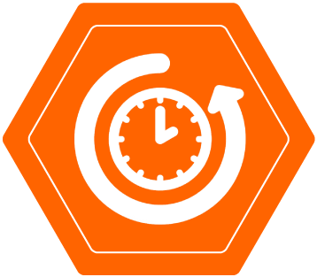

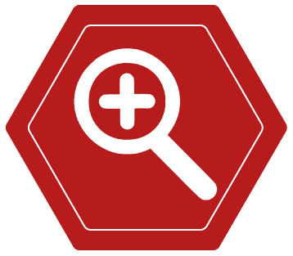

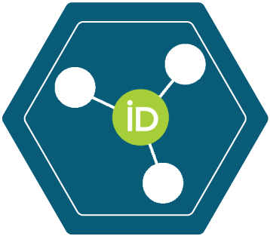
Researchers
All your research information accessible via your own unique profile, to be used wherever you need it.
 | Uniquely yours. Distinguish yourself and claim credit for your work while controlling access to your data, no matter how many people have your same (or similar) name.
 | Name flexibility. ORCID helps reduce the negative consequences of name changes so you will no longer be limited to the name you used when you began your career.
 | More time for research. By allowing trusted organizations to add your research information to your ORCID record, you can spend more time conducting your research and less time managing it!
 | Control your visibility and discovery. ORCID links all your research together, while you control the visibility of each piece of data. Easily see links to your research activities in one place—affiliations, funding, publications, and other contributions.
 | Reduced administrative burden. Experience greater ease as an increasing number of manuscript submission and grant application forms can be auto-populated when you log into their systems with your ORCID. Spend less time re-entering your data!
 | Portable profile data. Easily share the data in your record with an increasing number of funding, publications, data repositories, and other research workflows.

Slide 9


Universities and Research Institutions
Stay up to date with the research that comes from your scholars – while making their lives easier.
 | Name disambiguation. Have confidence that you have correctly identified contributions from your researchers, regardless of the popularity or variability of their names.
 | Better research connections. Follow your researchers' careers even after they leave your institution. Keep better track of collaborators and peers at other institutions.
 | Reduce costs. Reduce the costs required to track the research that comes from your institution by automatically accessing authoritative trusted publication and funding data from your researchers' ORCID records.
 | Improved visibility of outputs. Improve the visibility of your researchers' outputs and ensure they get the recognition they deserve by automatically writing authoritative, trusted affiliation data via integration with the ORCID registry.
 | Reduced administrative burden. Increase both efficiency and quality in critical processes like assessment exercises. Avoid time spent re-entering data during submission, review, and reporting. When your researchers have more time to spend on research, you save money!
 | Interconnected infrastructure. The ORCID registry is an open, interconnected hub of profile data. By integrating with ORCID, you can contribute affiliation data and extend the reach of your systems. Sharing data with ORCID can help you to avoid being locked into costly, proprietary systems.
Notes:
This is Kaya Loloma, a librarian at New Arizona State University*. She's responsible for helping researchers locate the correct research and understand their impact. She and her colleagues are also responsible for the affordability/value of journal and other service access, user experience, library systems and the physical library itself. Her roles overlap at times with the research office staff in many institutions and reporting of outcomes/impact to other places in the institution.
*not a real university!

Slide 10


Publishers, Associations, and Conferences
Improve the integrity of submission, review, and discovery processes with reliable author and reviewer information.
 | Understand your researchers. Collect authenticated iDs for your authors and reviewers to better understand their academic records. ORCID can also help with OA policy compliance and transformative agreement management by acting as an open, trusted source of affiliation data.
 | Better reviewer selection. More complete profile data makes reviewer selection process easier and helps to discover possible conflicts of interest. When recruiting new reviewers, editors can assign reviews based on previous contributions and activities.
 | Peer review recognition. Acknowledge reviewers’ expertise and provide recognition for all their contributions—reviews, editorial board membership, etc.
 | Enhanced discoverability for your authors. Writing publication data to your authors' ORCID records increases discoverability and helps them claim credit for their work.
 | A more consistent experience. Having your users sign in with ORCID reduces the frustration and burden of managing multiple credentials. Linking authors between different systems saves time during submission, review, and reporting.
 | Interconnected infrastructure. The ORCID registry is an open, interconnected hub of profile data. By integrating with ORCID, you can contribute publication data and extend the reach of your systems. Consuming interoperable data from ORCID helps reduce your dependence on costly proprietary systems.
Notes:
This is Louise Williams, a Journal Editor at a publisher in the United Kingdom. She is responsible for advancing knowledge in the field of infectious diseases - a highly specialized and nuanced area of study. At the same time, Louise must convince authors, reviewers, and readers alike that their Science and Technologies* journal is the absolute best to publish in. Only through scrutinous and deliberate effort does she find the best authors and the most qualified reviewers to make contributions to their journal. Louise sometimes has trouble finding the most capable reviewers for their past few articles. As a journal editor she would like to make the process of evaluating reviewers simpler.

Slide 11

Funders and Facilities
Reduce the burden of administering grants and track their impact in a cost-effective way.
 | Trustworthy award attribution. Ensure the right applicant is awarded, and enable better transparency throughout the funding process. Preserve the integrity of downstream analysis.
 | Enhanced ease of reviewer selection. More complete applicant data makes reviewer selection process easier and helps to discover possible conflicts of interest. When recruiting new reviewers, program managers can assign reviews based on previous contributions and activities, even across other funders.
 | Increased research ROI. Writing rich data to ORCID records can potentially allow better tracking of research outcomes supported by your funding, ultimately leading to better resource allocation decisions.
 | Accurate attribution and enhanced discoverability. Standardized identifiers and open data can help increase discoverability, recognition, and accuracy of attribution of the research you fund or facilitate, even beyond the period of performance.
 | Reduced administrative burden for both your staff and researchers. Re-use of standardized data improves quality and accuracy and can save time, money and effort. Having users sign in with ORCID reduces their frustration and burden of managing multiple credentials and saves time during submission, review, and reporting.
 | Interconnected infrastructure. Help accelerate knowledge discovery and increase the integrity, transparency and reproducibility of research by encouraging FAIR Data Principles and Open Science practices through persistent identifiers and standardized, openly-accessible data.
Notes:
This is Nicholas Spencer, a facility program manager for a national research center. He and his colleagues administer access to infrastructure, including consulting on project or experimental design, data stewardship planning, reviews project proposals, and manages facility or project staff. They also participate in or manage an annual review process or sets annual budget for facilities.

Slide 12

Policy Makers and Government
 | Trustworthy recognition of your researchers and research. Have confidence that the contributions from researchers in your country or region have been correctly identified, that you can easily understand the range of research activities, and can identify conflicts of interest.
 | Transparent, trustworthy decision-making. Use insights gained from standardized, open data to hone your research vision, refine policies and clarify expectations for your country's research community.
 | Increased return on investment. Increase your return on investment by better understanding the full impact of your research efforts across your scholarly ecosystem – regardless of the variability of the research systems in use.
 | Accurate attribution. Ensure that the affiliations, research outputs, contributions, and activities of your county's or region's researchers are correctly attributed.
 | Reduced administrative burden. Reduce time and effort for everyone – especially in critical assessment exercises – by reusing existing, validated data about research outputs.
 | Interconnected infrastructure. Help accelerate knowledge discovery, international collaboration, and increase the integrity, transparency and reproducibility of research by encouraging FAIR Data Principles and Open Science practices through persistent identifiers and standardized, openly-accessible data.
Elevate the transparency and integrity of your research strategy and policy with trustworthy data.
Notes:
This is Shannon Powell, senior senior policy maker for a governmental agency. She is responsible for designing and implementing national or international policy and tracking its impact.

Slide 13

Services and Vendors
Increase the value of your services with authoritative, quality profile data.
 | Name disambiguation. Using our authoritative, high quality profile data can increase the precision of your researcher profiles, regardless of the popularity, variability, or language of the names.
 | A broader view of outputs. Create a broader view of a researcher, institution or funder's contributions by including activities beyond publications such as affiliations, datasets, peer reviews, grants, and patents.
 | Increased platform ROI. Create better insights for your customers from more comprehensive, quality data, while improving efficiency and saving time through automation.
 | Improved visibility and discoverability. Improve the visibility and discoverability of your service by adding links to ORCID records, and connecting your own IDs in ORCID's openly-accessible data.
 | Reduced administrative burden. No need to patch together data for reporting needs—an increasing number of connected systems means easier access to high quality data, all in one place. Having your customers' users sign in with ORCID reduces the frustration and burden of managing multiple credentials.
 | Rich, interconnected user experience. Enable your customers to gain more value from your services by enabling interoperability using standardized identifiers. Extend the reach of your systems and enrich the entire research ecosystem by pushing and pulling quality data to and from ORCID records.
Notes:
This is Trevor Sullivan. He works at a company that provides a discovery insight platform to the scholarly community. In addition to discovery insight platforms, ORCID has a variety of service providers, including: manuscript submission, publishing systems, repositories, CRIS systems, grant management, profile platforms, open infrastructure providers (PID systems), and identity systems. The services of these organizations may be tailored towards researchers, or to other stakeholders such as universities or funders.

Slide 14
Feedback and Suggestions

Slide 15
Let us know if you have any questions
If you have any questions or comments about these value stories, we would be happy to hear from you! Please reach out to your ORCID Engagement Lead.

